Slide 1
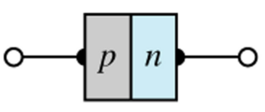
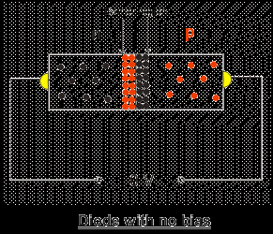
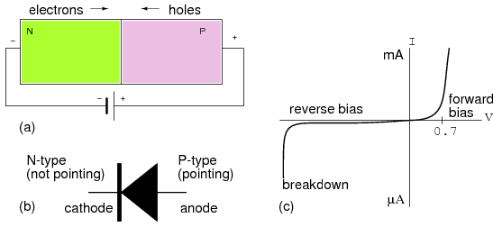
Diodes

Slide 2
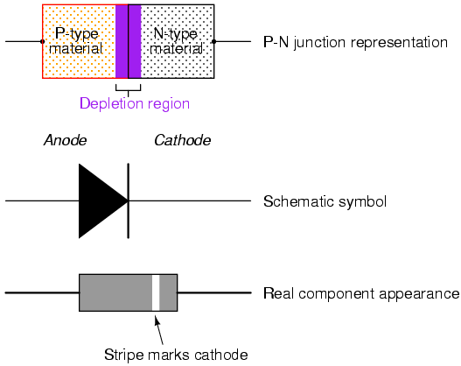
Diode
Diodes are electronic devices created by bringing together a p-type and n-type region within the same semiconductor lattice.

Slide 3
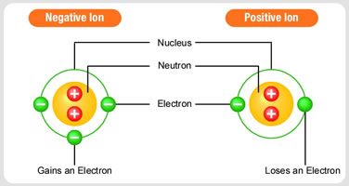

Slide 4
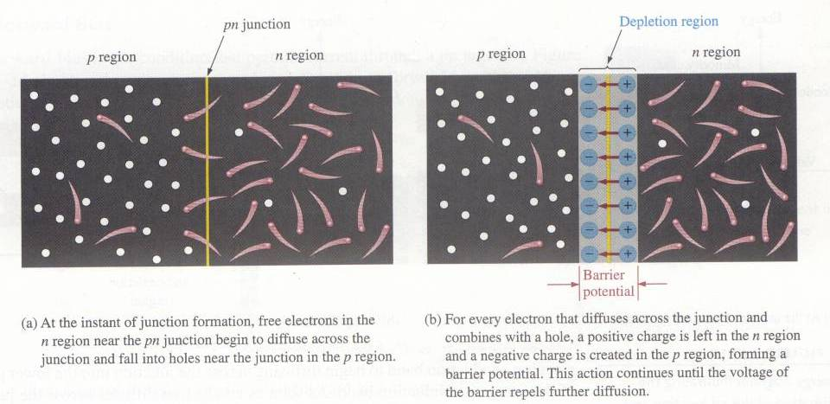
The PN-Junction
The interface in-between p-type and n-type material is called as
pn-junction.
This depletion region becomes an insulating layer.

Slide 5
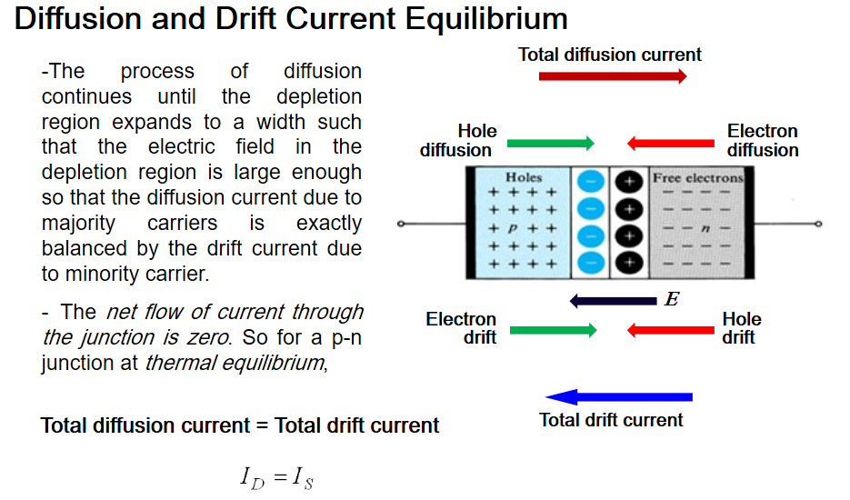
Current Flow Across Junction: Equilibrium
At equilibrium, the drift current flowing in one direction cancels out the diffusion current flowing in the opposite direction, creating a net current of zero.

Slide 6
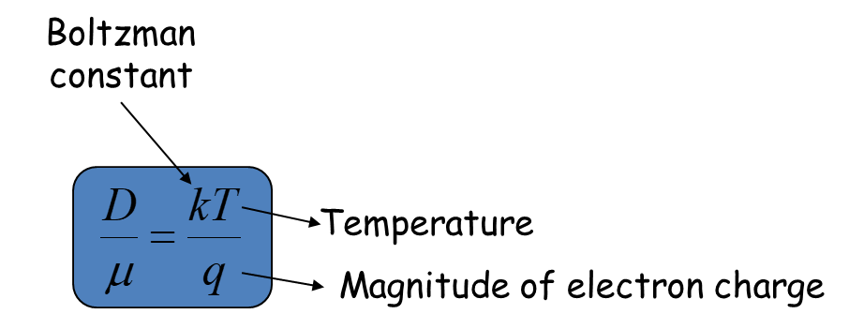
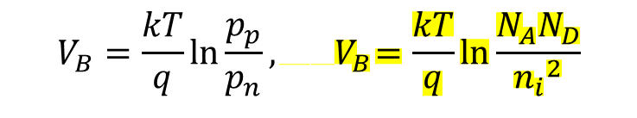
Built-in Potential
drift current
diffusion current
Number acceptor atoms
$$V_{B}=\frac{kT}{q}\ln{\frac{p_{p}}{p_{n}}},{ V}_{B}=\frac{kT}{q}\ln{\frac{N_{A}N_{D}}{{n_{i}}^{2}}}$$
Number donor atoms
Free electrons in intrinsic silicon
Barrier potential
Because of the electric field across the junction, there exists a built-in potential. Its derivation is shown above.

Slide 7
P-N
P
N
Bo ro n
3 valance electron s
Pho sphorus
5 valance electron s

Slide 8
Depletion Region
P | - - | - - | + + + + | N
 | - | - | + +
 | - | - | + +
 | - | - | + +
-Xp Xn
𝑥_{𝑝}𝑁_{𝐴} = 𝑥_{𝑛}𝑁_{𝐷} 𝑊= 𝑥_{𝑝} + 𝑥_{𝑛}
Number acceptor atoms
Number donor atoms

Slide 9
Depletion Region
P | - - | - - | + + + + | N
 | - | - | + +
 | - | - | + +
 | - | - | + +
-Xp Xn
Barrier potential
Width of unbiased depletion region

Slide 10
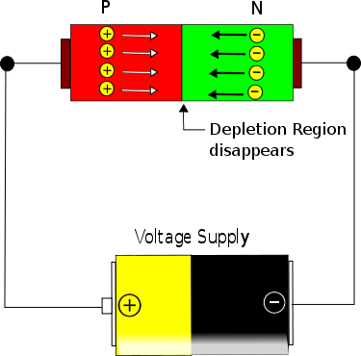
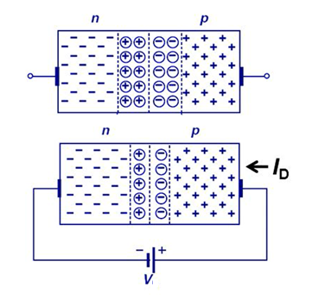
Forward Bias
In forward bias the P-Region of the diode is connected with the positive terminal of the battery and N-region is connected with the negative region.
During the forward bias the following process occurs. The positive of the battery pumps more holes into the P-region of the diode. The negative terminal pumps electrons into the N-region.
The excess of charge in P and N region will apply pressure on the depletion region and will make it shrink. As the voltage increases the depletion layer will become thinner and thinner and hence diode will offer lesser and lesser resistance. Since the resistance decreases the current will increase (though not

Slide 11
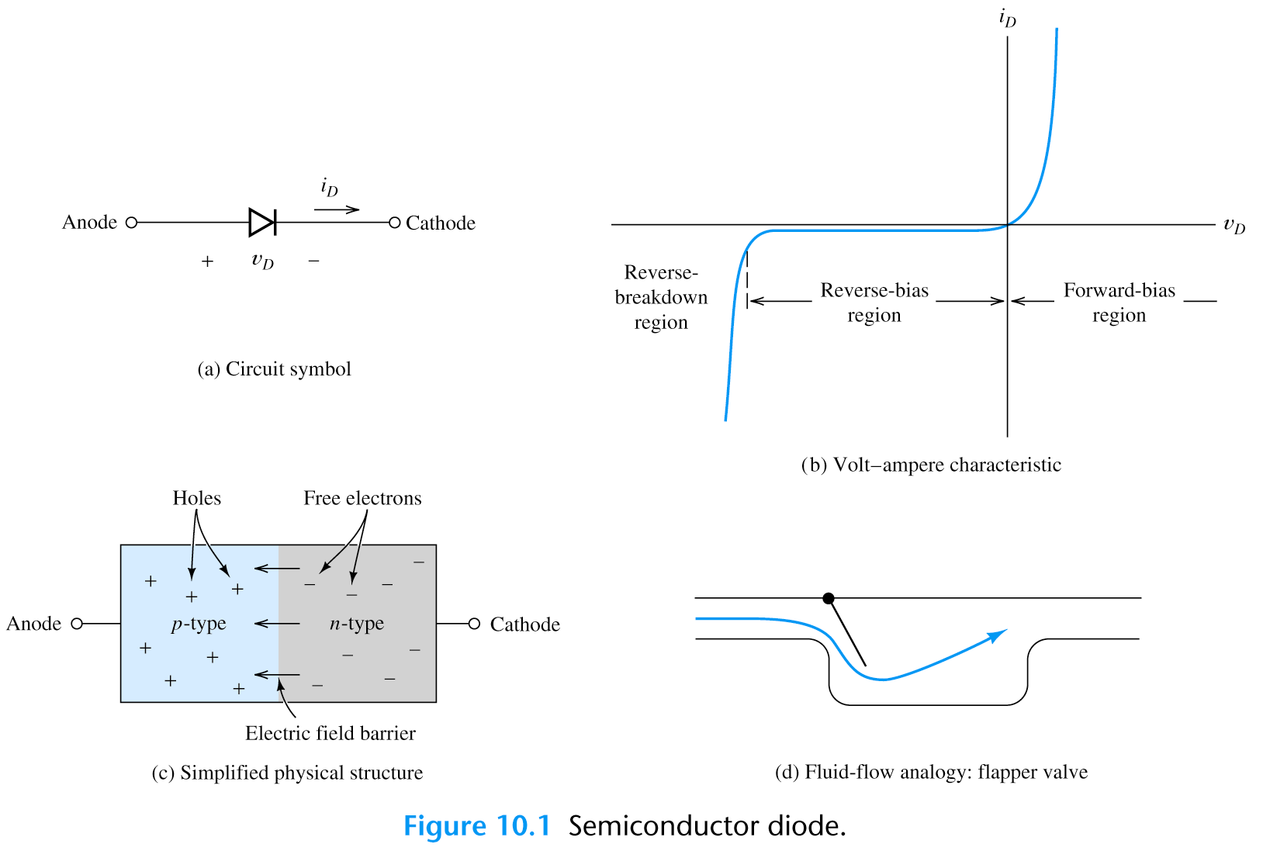
Forward Bias
At one particular voltage level (V_{f} called as threshold / cut-off voltage) the depletion layer disappears and from this point on the diode starts to conduct very easily. From this point on the diode, current increases exponentially to the voltage applied.

Slide 12
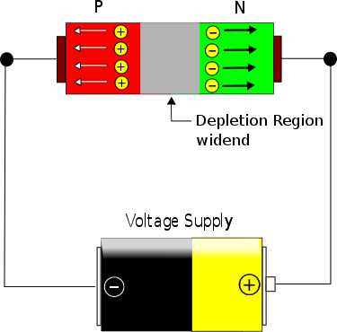
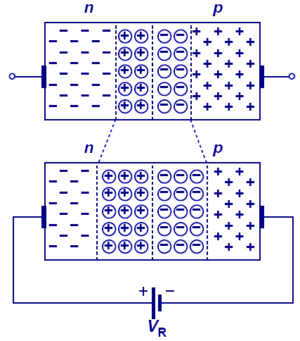
Reverse Bias
In reverse bias the P-type region is connected to negative voltage and N-type is connected to positive terminal as shown above.
In this condition the holes in P-type gets filled by electrons from the battery / cell (in other words the holes get sucked out of the diode).
The electrons in N-type material is sucked out of the diode by the positive terminal of the battery. So initially the depletion layer widens (see image above) and it occupies the entire diode. The resistance offered by the diode is very huge.

Slide 13
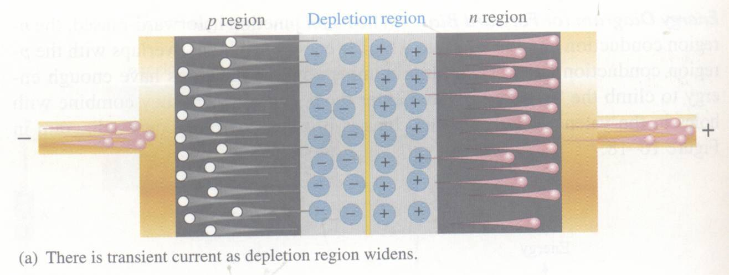
Reverse Bias
Negative terminal of the DC voltage source is connected to the p region and positive terminal of the DC voltage source to the n region. Depletion region widens until its potential difference equals the bias voltage, majority-carrier current ceases.

Slide 14
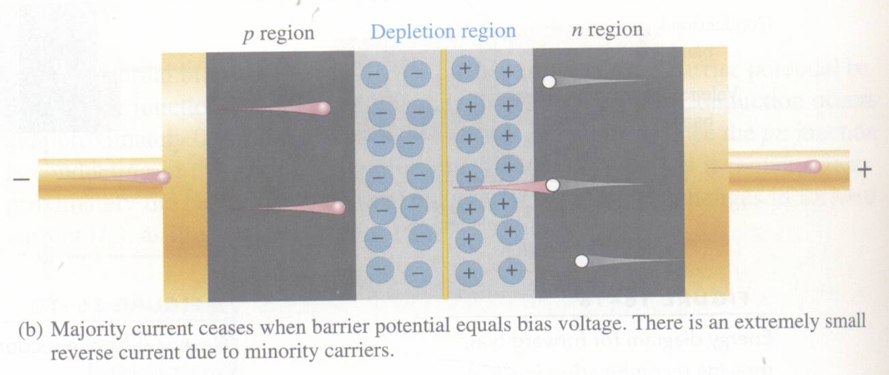
Reverse Bias
Majority-carrier current ceases.
However, there is still a very small current produced by minority carriers.
The current that flows in reverse bias is only due to minority charge which is in nano amperes in silicon and micro amperes in high power silicon and germanium diodes.

Slide 15
Reverse Breakdown
As reverse voltage reach certain value, avalanche occurs and generates large current.
If the reverse voltage is made high enough, then the junction will break down and almost all electrons will flow from anode to cathode (under normal conditions, electrons flow from cathode to anode, when forward biased).

Slide 16
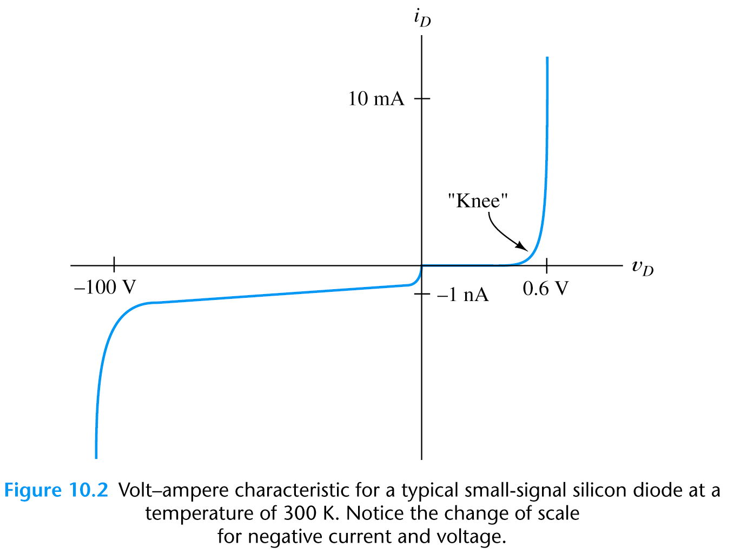
The Diode Characteristic I-V Curve

Slide 17
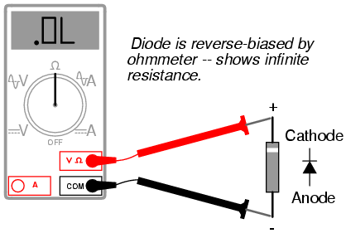
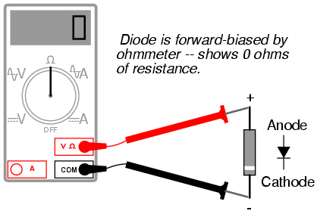
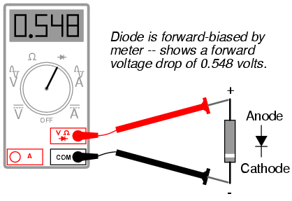
Diode – Characteristic

Slide 18
Diode in Reverse Bias
When the N-type region of a diode is connected to a higher potential than the P-type region, the diode is under reverse bias, which results in wider depletion region and larger built-in electric field across the junction.

Slide 19
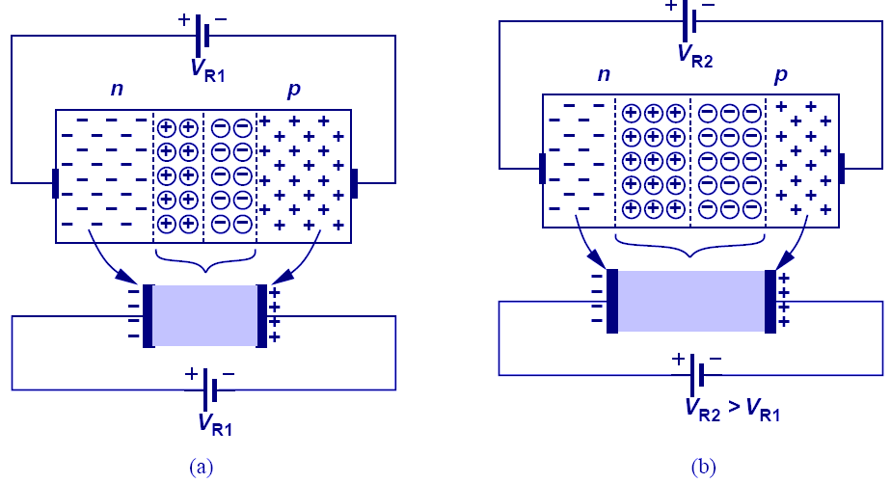
Reverse Biased Diode’s Application: Voltage-Dependent Capacitor
The PN junction can be viewed as a capacitor. By varying V_{R}, the depletion width changes, changing its capacitance value; therefore, the PN junction is actually a voltage-dependent capacitor.

Slide 20
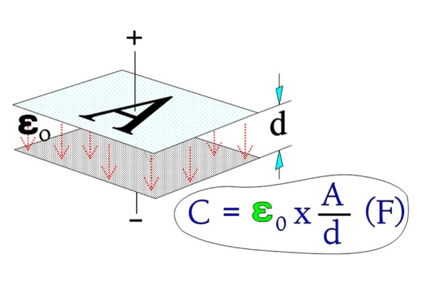
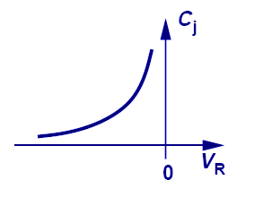




Voltage-Dependent Capacitance
$$C_{j}=ε_{si} A/W_{dep}$$
$W_{dep}$: Width of depletion region
$A$: Cross-sectional area of PN junction
$ε_{si}$: Dielectric permittivity of semiconductor material
The equations that describe the voltage-dependent capacitance are shown above.

Slide 21
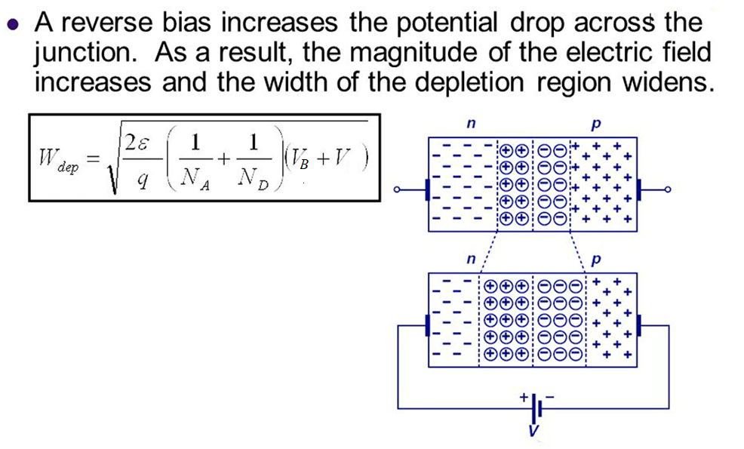
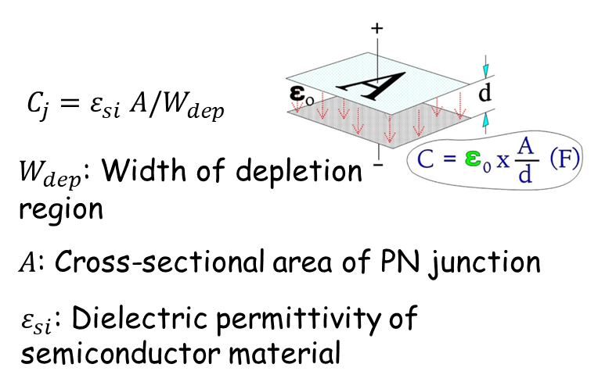
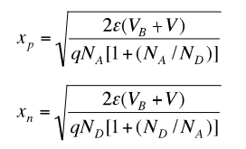
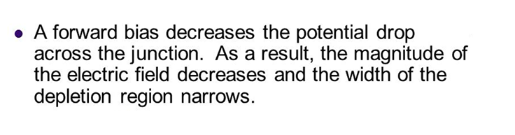
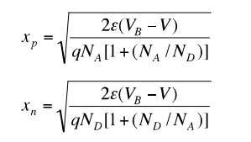
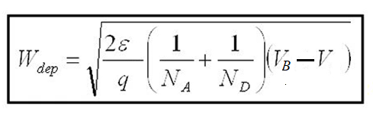
x_{n}
x_{p}
𝑊_{dep}= 𝑥_{𝑝} + 𝑥_{𝑛}
x_{n}
x_{p}
𝑊_{dep}= 𝑥_{𝑝} + 𝑥_{𝑛}

Slide 22
Depletion Region

Slide 23
Shockley Equation
Geometry, doping and material constants are lumped in I_{s}

Slide 24
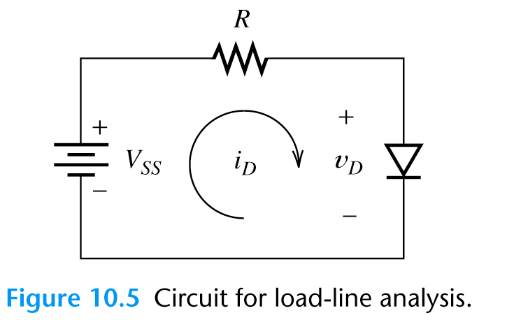
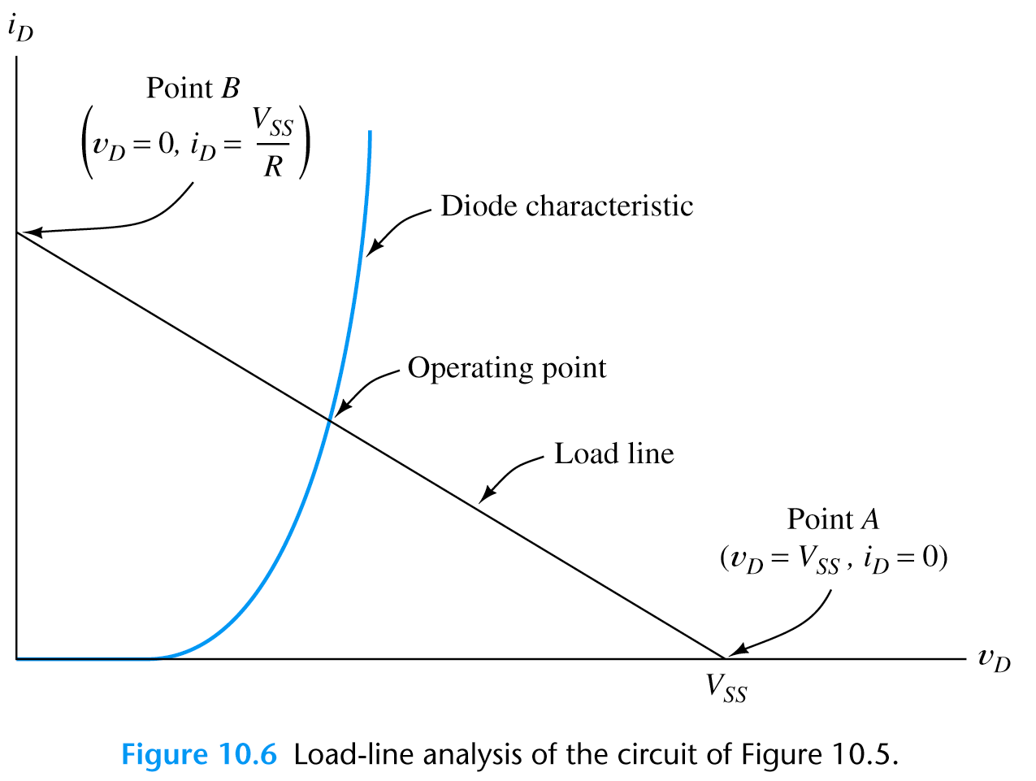
Load-Line Analysis of Diode Circuit

Slide 25
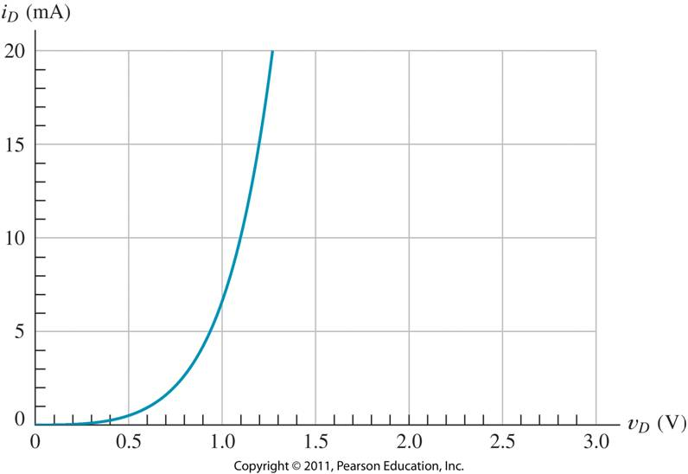
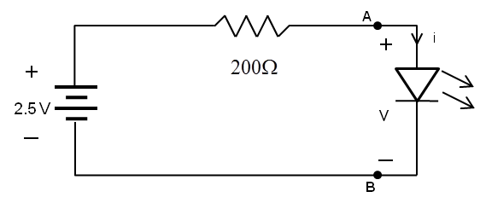
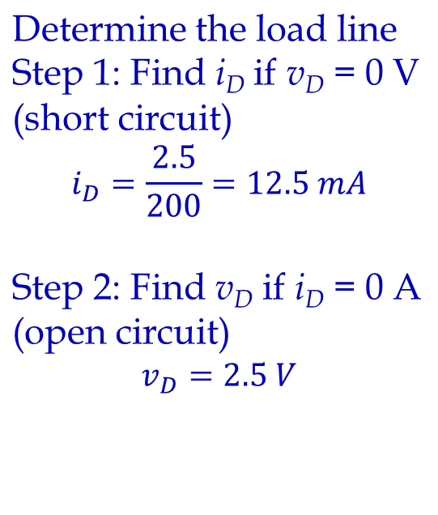
Find the current i and the voltage v across LED diode in the circuit shown on Figure left. Assume that the diode characteristic is shown on Figure right.
Draw load line. Intersection of load line and diode characteristic is the i and v across LED diode: v ≈ 1.02 V and i ≈ 7.5 mA.

Slide 26
Example Load-Line Analysis
1.3mA
0.7

Slide 27
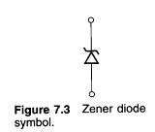
The Zener Diode
* Zener diode is designed for operation in the reverse-breakdown region.
* The breakdown voltage is controlled by the doping level (-1.8 V to -200 V).
* The major application of Zener diode is to provide an output voltage that is stable despite changes in input voltage.

Slide 28
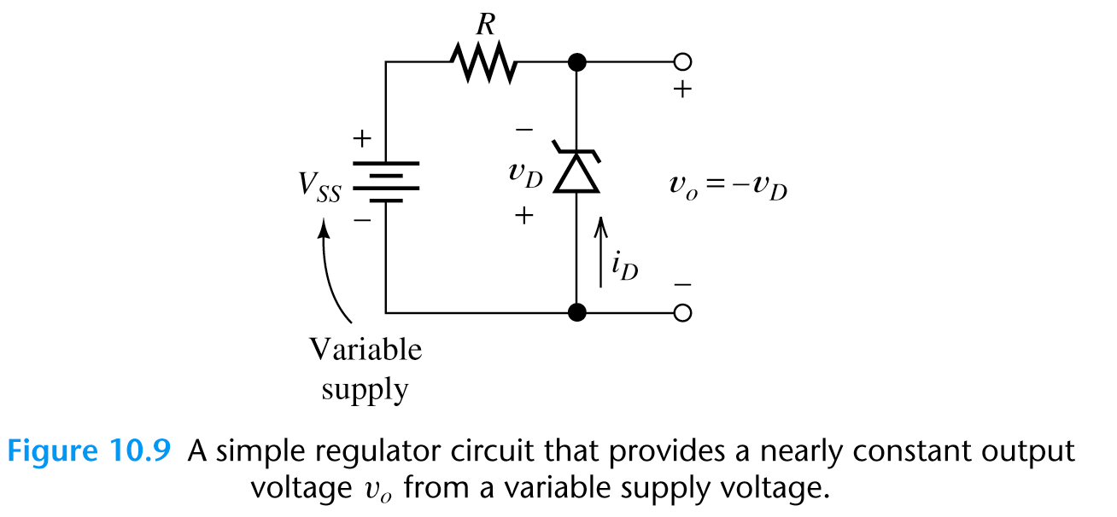
Zener-Diode Voltage-Regulator Circuits
Sometimes, a circuit that produces constant output voltage while operating from a variable supply voltage is needed. Such circuits are called voltage regulator.
The resistor limits the diode current to a safe value so that Zener diode does not overheat.
The Zener diode has a breakdown voltage equal to the desired output voltage.

Slide 29
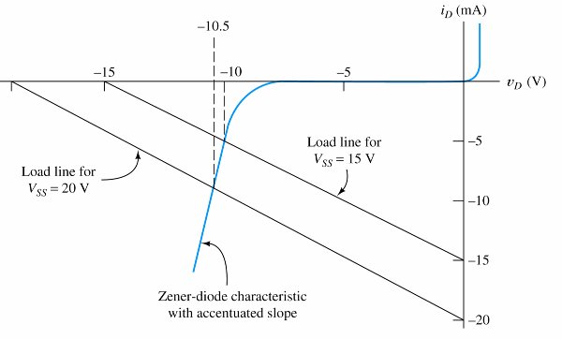
Zener-Diode Voltage-Regulator Circuits (Example)
Actual Zener diode
performs much better!

Slide 30
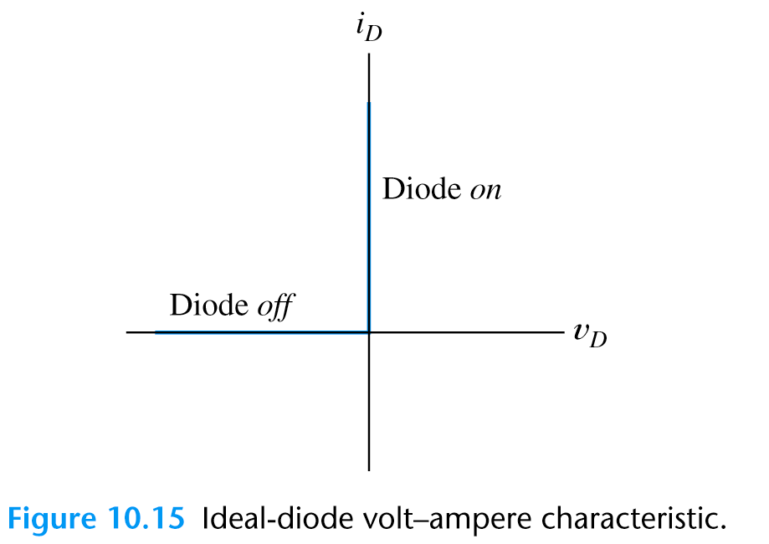
Ideal-Diode Model
* Graphical load-line analysis is too cumbersome for complex circuits,
We may apply “Ideal-Diode Model” to simplify the analysis:
(1) in forward direction: short-circuit assumption, zero voltage drop;
(2) in reverse direction: open-circuit assumption.
* The ideal-diode model can be used when the forward voltage drop and reverse currents are negligible.

Slide 31
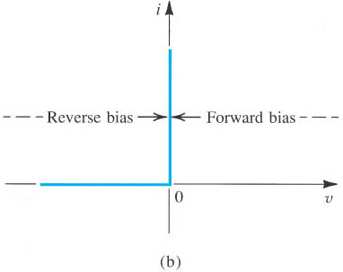
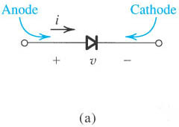
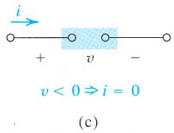
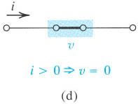
Ideal-Diode Model
Figure The ideal diode: (a) diode circuit symbol; (b) i–v characteristic; (c) equivalent circuit in the reverse direction; (d) equivalent circuit in the forward direction.
Microelectronic Circuits - Fifth Edition Sedra/Smith
Notes:
sedr42021_0301a.jpg

Slide 32
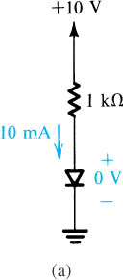

Question: Calculate the voltage and current values of diodes by using ideal diode model.
Notes:
sedr42021_0302a.jpg

Slide 33
Ideal-Diode Model Analysis Method
* In analysis of a circuit containing diodes, we may not know in advance which diodes are on and which are off.
* What we do is first to make a guess on the state of the diodes in the circuit:

Slide 34
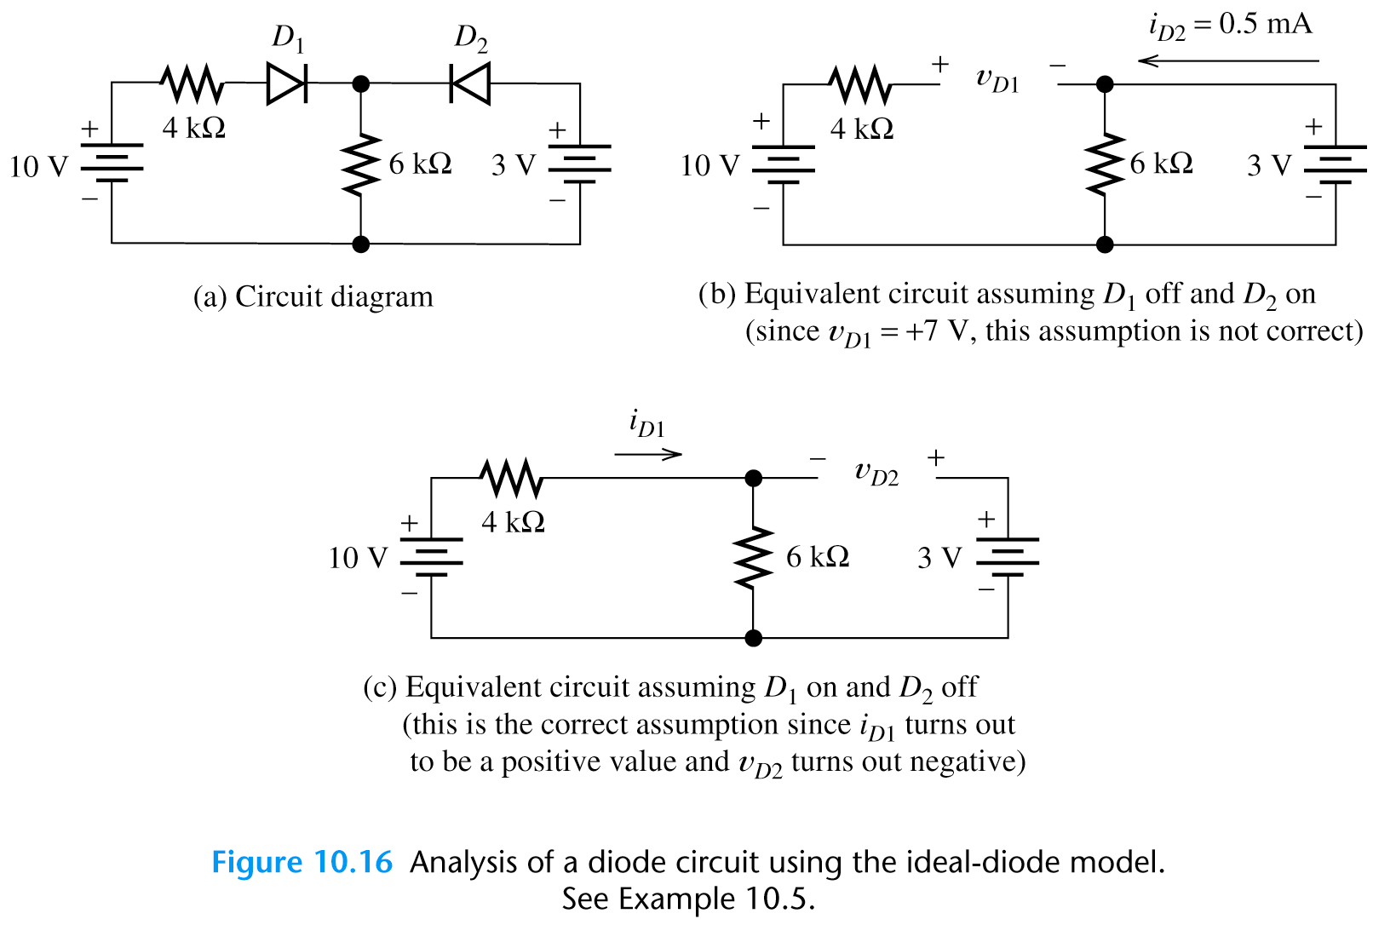
Example – Analysis by Assumed Diode States

Slide 35
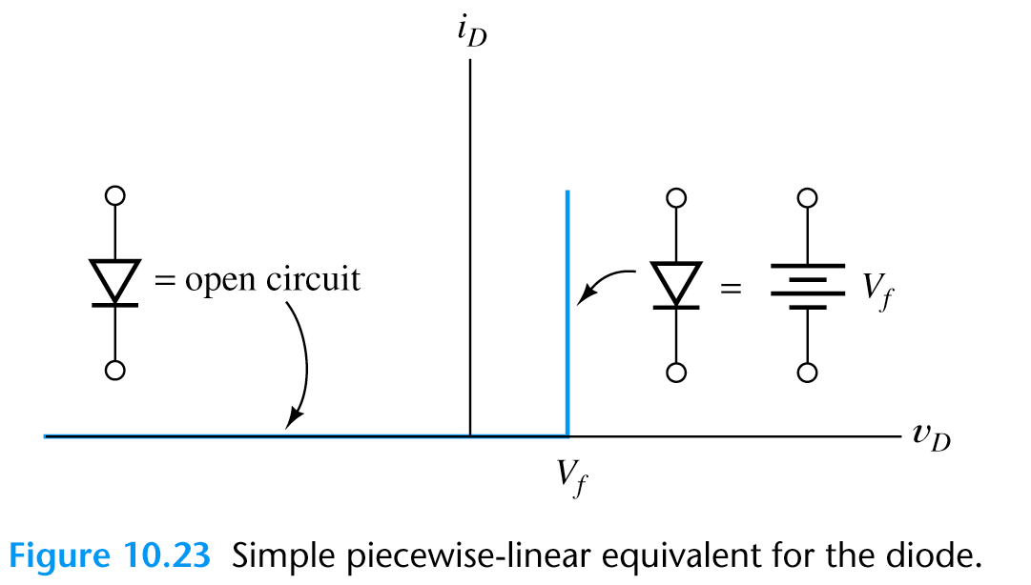
Modified Ideal-Diode Model
Ideal-Diode Model
Modified Ideal-Diode Model
Modified ideal-diode model is usually accurate enough in most of the circuit analysis.

Slide 36
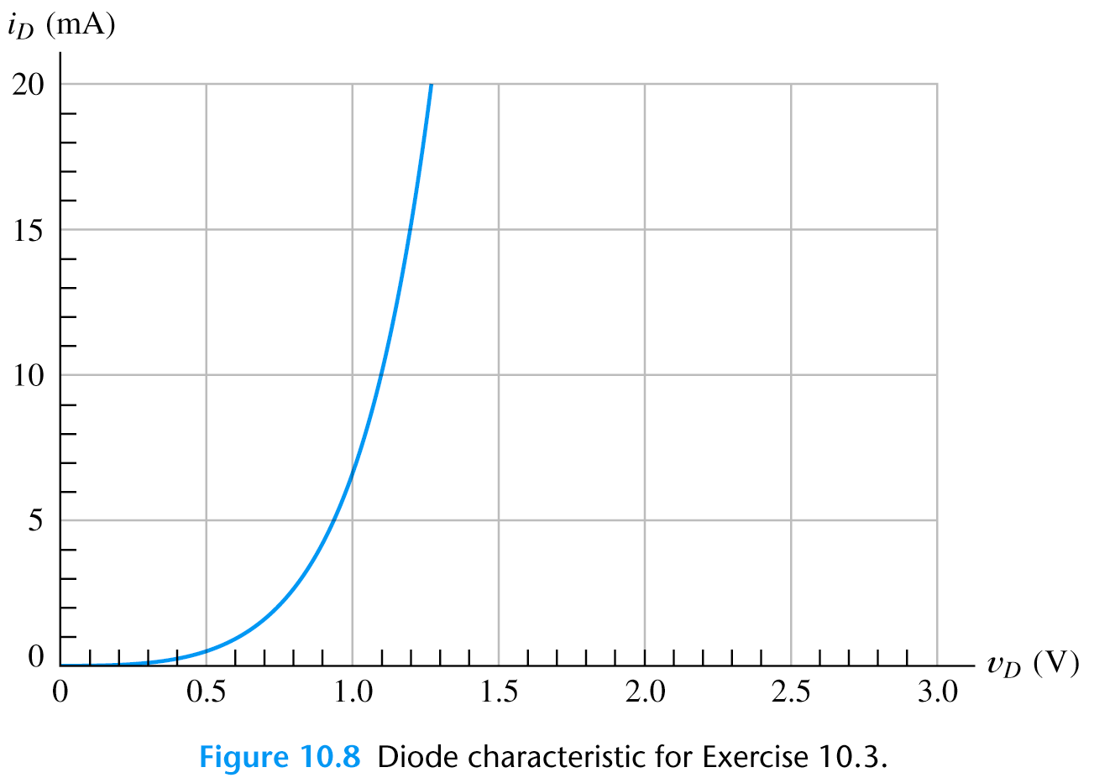
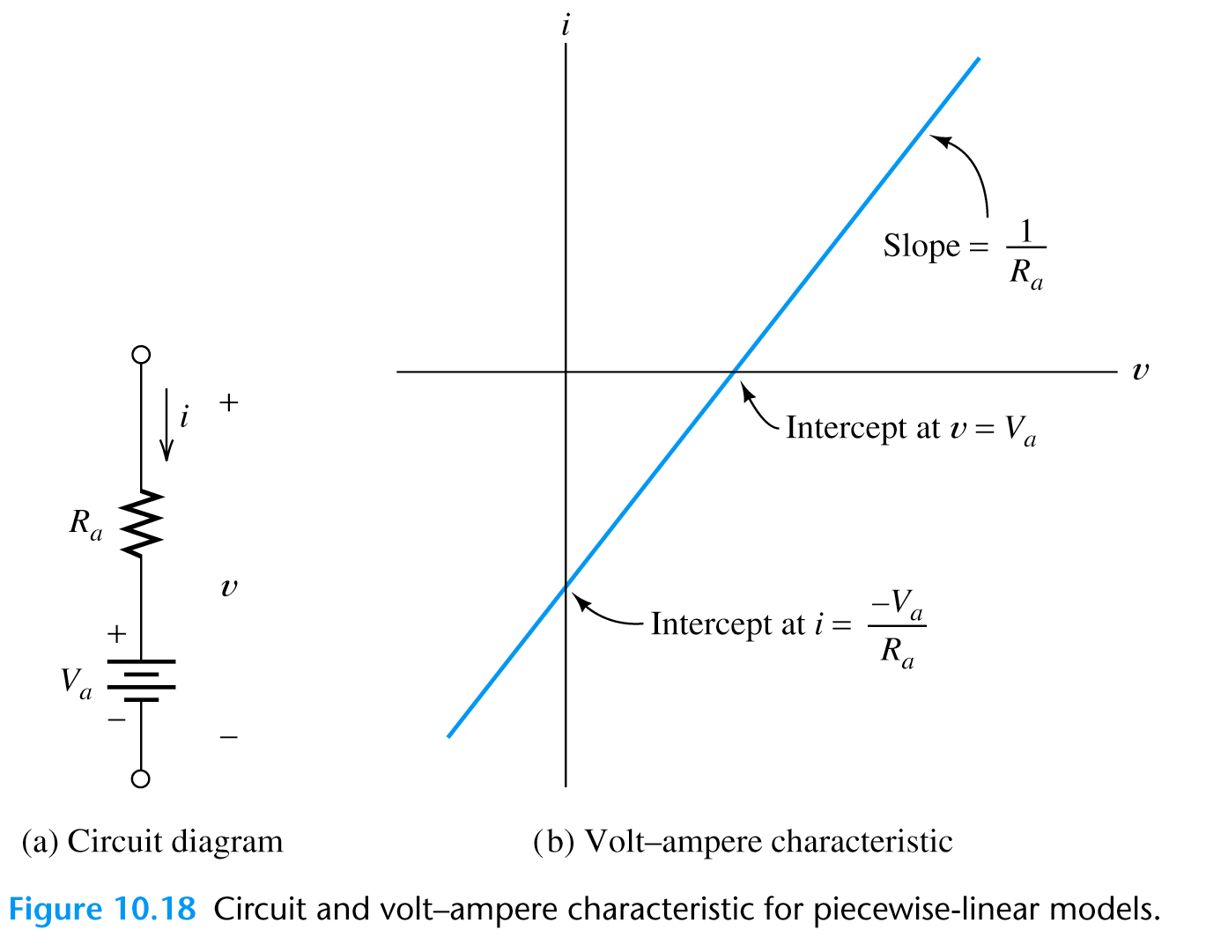
Piecewise Linear Diode Model
More accurate than the ideal diode model.
(2) We can model each section of the diode
I-V curve with resistor (R_{a}) in series with a fixed voltage source (V_{a})
v = r_{z}i + V_{a}
(1) Diode V-I curve approximated by
straight line segments

Slide 37
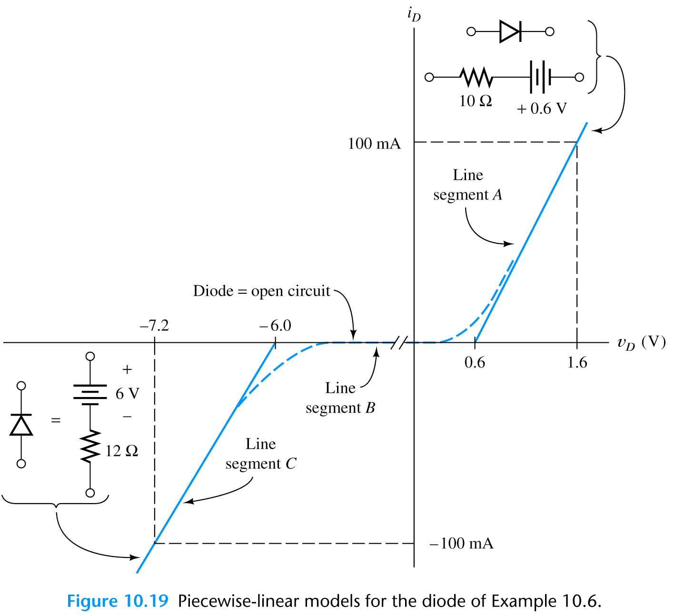
Example: Find circuit models for the Zener-diode volt-ampere curve shown in figure below using the piecewise-linear diode model.
Draw a line
Look for intercept (0.6V) & the reciprocal of the slope (1/R)
(1.6V-0.6V)/100mA=10Ω
Open circuit approximation
Repeat for the reverse bias

Slide 38
Zener-diode piecewise-linear diode model for reverse breakdown region.
We observe that for currents greater than the knee current IZK , the i–v characteristic is almost a straight line.
Model for the zener diode for reverse breakdown region.
Figure shows details of the diode i–v characteristic in the breakdown region.

Slide 39
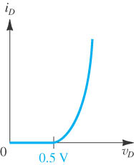
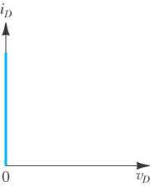






Diode curve
İdeal diode model
Modified ideal diode model
Piecewice linear diode model
Notes:
sedr42021_tb0301.jpg

Slide 40


Diode Applications

Slide 41

Rectifier Circuits
* Rectifiers convert AC power to DC power.
* Rectifiers form the basis for electronic power suppliers and battery charging circuits.
Half-Wave Rectifier

Slide 42

Basic Battery-Charging Circuit
The current flows only in the direction that charges the battery.
By using Ideal-Diode Model

Slide 43


Full-Wave Rectifier Circuits
Two half-wave rectifier with a common ground.
When upper source supplies “+” voltage to diode A, the lower source supplies “-” voltage to diode B; and vice versa.
We can also smooth the output by using a large capacitance.
By using Ideal-Diode Model

Slide 44

Clipper Circuits
* A portion of an input signal waveform is “clipped” off.
By using Ideal-Diode Model

Slide 45


Small Signal Analysis of Diode

Slide 46



Linear Small-Signal Equivalent Circuits
In most of the electronic circuits, DC supply voltages are used to bias a nonlinear device at an operating point and a small signal is injected into the circuits.
* We often split the analysis of such circuit into two parts:
(1) Analyze the DC circuit to find operating point,
(2) Analyze the small signal (by using the “linear small-
signal equivalent circuit”.)
Small-Signal is applied by a voltage source

Slide 47
Linear Small-Signal Equivalent Circuits
if we consider a sufficiently small segment, any nonlinear curve is approximately linear (straight)
THEN
We can find a linear small-signal equivalent circuit for the nonlinear device to use in the AC analysis
The small signal diode can be substituted by a single equivalent resistor.

Slide 48
Linear Small-Signal Equivalent Circuits
A diode in linear small-signal equivalent
circuit is simplified to a resistor.
* When small AC signal injects, it swings the Q point slightly up and down.
* If the signal is small enough, the characteristic is straight.
We first determine the operating point (Q point) by DC bias.

Slide 49

Linear Small-Signal Equivalent Circuits

Slide 50

Linear Small-Signal Equivalent Circuits
By using these two equations, we can analyse diode behavior in small AC signal analysis.
Note: An AC voltage of fixed amplitude produces different AC current change at different Q point.

Slide 51


Linear Small-Signal Equivalent Circuits

Slide 52
Voltage-Controlled Attenuator
The function of this circuit is to produce an output signal that is a variable fraction of the AC input signal.
Two large coupling capacitors: behave like short circuit for AC signal and open circuit for DC, thus the Q point of the diode is unaffected by the ac input and the load.
Impedance of a capacitor

Slide 53



Voltage-Controlled Attenuator

Slide 54


Exercise - Voltage-Controlled Attenuator
$$\text{Given}\text{: }\text{R}=\text{100}Ω\text{, }{\text{R}}_{C}=R_{L}=\text{2}\text{k}Ω\text{, }\text{diode} \text{n}=\text{1 }\text{at}\text{ 300}\text{K} \\ \text{Find} \text{the} \text{Q}\text{−}\text{point} \text{and} {\text{A}}_{v}\text{values} \text{for} {\text{V}}_{C}=\text{1.6 }\text{and}\text{ 10.6}\text{V}\text{ (}\text{assuming} {\text{V}}_{D}=\text{0.6}\text{V}\text{)}$$
$$\text{First} \text{apply} \text{DC} \text{analysis} \text{to} \text{find} \text{the} \text{diode} \text{Q} \text{point}\text{, } \\ I_{\text{DQ}}=\frac{V_{C}\text{−0.6}}{R_{C}}\text{, }r_{d}=\frac{nV_{T}}{I_{DQ}} \text{with} {\text{V}}_{T}=\text{0.026}\text{V}$$

Slide 55
Question: If v_{s} (t)= 0.01 sinωt, calculate i_{d} (t) by using Modified Ideal Diode Model (V_{d}=0.7V)
Step 1: D.C. Analysis
Small signal sources are removed.
KVL :
V_{R 2} = 0.7 + 0.7 = 1.4 V
I₂ =
^{V}R 2
= 0.7mA
2
V_{R 1} = 5.0 −V_{R 2} = 5.0 − 1.4 = 3.6 V
I₁
₌ ^{V}R 1
= 3.6 mA
1
I_{D}^{i}
= I₁ − I₂=2.9mA

Slide 56
Question: If v_{s} (t)= 0.01 sinωt, calculate i_{d} (t) by using Modified Ideal Diode Model (V_{d}=0.7V)
Step 2: A.C. Analysis
DC sources are removed. AC model of diode is placed.

